Slide 1
Chapter 7: A First Look at GUI Applications
Starting Out with Java: From Control Structures through Objects
Second Edition
by Tony Gaddis

Slide 2
Chapter Topics
Chapter 7 discusses the following main topics:
Introduction
Creating Windows
Equipping GUI Classes with a main method
Layout Managers
Radio Buttons and Check Boxes
Borders
Focus on Problem Solving: Extending Classes from JPanel

Slide 3
Introduction
Many Java application use a graphical user interface or GUI (pronounced “gooey”).
A GUI is a graphical window or windows that provide interaction with the user.
GUIs accept input from:
the keyboard
a mouse.
A window in a GUI consists of components that:
present data to the user
allow interaction with the application.

Slide 4
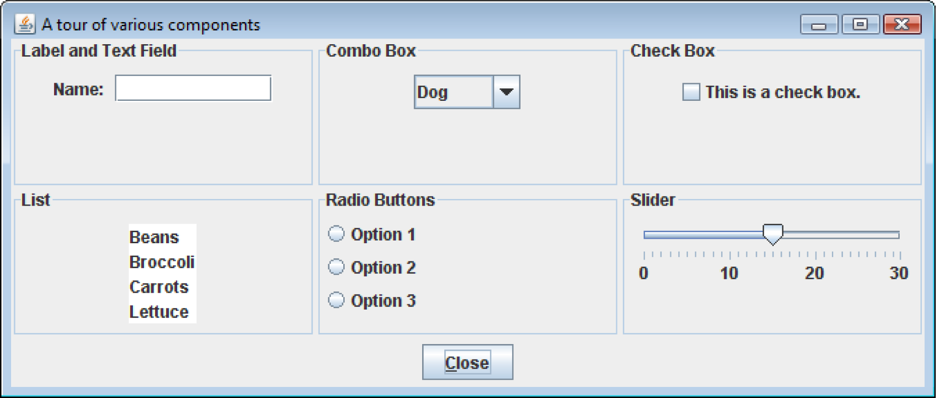
Introduction
Some common GUI components are:
buttons, labels, text fields, check boxes, radio buttons, combo boxes, and sliders.

Slide 5
JFC, AWT, Swing
Java programmers use the Java Foundation Classes (JFC) to create GUI applications.
The JFC consists of several sets of classes, many of which are beyond the scope of this book.
The two sets of JFC classes that we focus on are AWT and Swing classes.
Java is equipped with a set of classes for drawing graphics and creating graphical user interfaces.
These classes are part of the Abstract Windowing Toolkit (AWT).

Slide 6
JFC, AWT, Swing
The AWT allows creation of applications and applets with GUI components.
The AWT does not actually draw user interface components on the screen.
The AWT communicates with a layer of software, peer classes.
Each version of Java for a particular operating system has its own set of peer classes.

Slide 7
JFC, AWT, Swing
Java programs using the AWT:
look consistent with other applications on the same system.
can offer only components that are common to all the operating systems that support Java.
The behavior of components across various operating systems can differ.
Programmers cannot easily extend the AWT components.
AWT components are commonly called heavyweight components.

Slide 8
JFC, AWT, Swing
Swing was introduced with the release of Java 2.
Swing is a library of classes that provide an improved alternative for creating GUI applications and applets.
Very few Swing classes rely on peer classes, so they are referred to called lightweight components.
Swing draws most of its own components.
Swing components have a consistent look and predictable behavior on any operating system.
Swing components can be easily extended.

Slide 9
Event Driven Programming
Programs that operate in a GUI environment must be event-driven.
An event is an action that takes place within a program, such as the clicking of a button.
Part of writing a GUI application is creating event listeners.
An event listener is an object that automatically executes one of its methods when a specific event occurs.

Slide 10
javax.swing and java.awt
In an application that uses Swing classes, it is necessary to use the following statement:
import javax.swing.*;
Note the letter x that appears after the word java.
Some of the AWT classes are used to determine when events, such as the clicking of a mouse, take place in applications.
In an application that uses an AWT class, it is necessary to use the following statement.
import java.awt.*;
Note that there is no x after java in this package name.

Slide 11
Creating Windows
Often, applications need one or more windows with various components.
A window is a container, which is simply a component that holds other components.
A container that can be displayed as a window is a frame.
In a Swing application, you create a frame from the JFrame class.

Slide 12
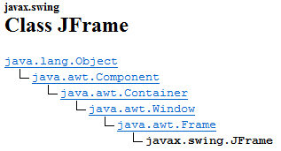
Class JFrame

Slide 13
Creating Windows
A frame is a basic window that has:
a border around it,
a title bar, and
a set of buttons for:
minimizing,
maximizing, and
closing the window.
These standard features are sometimes referred to as window decorations.

Slide 14
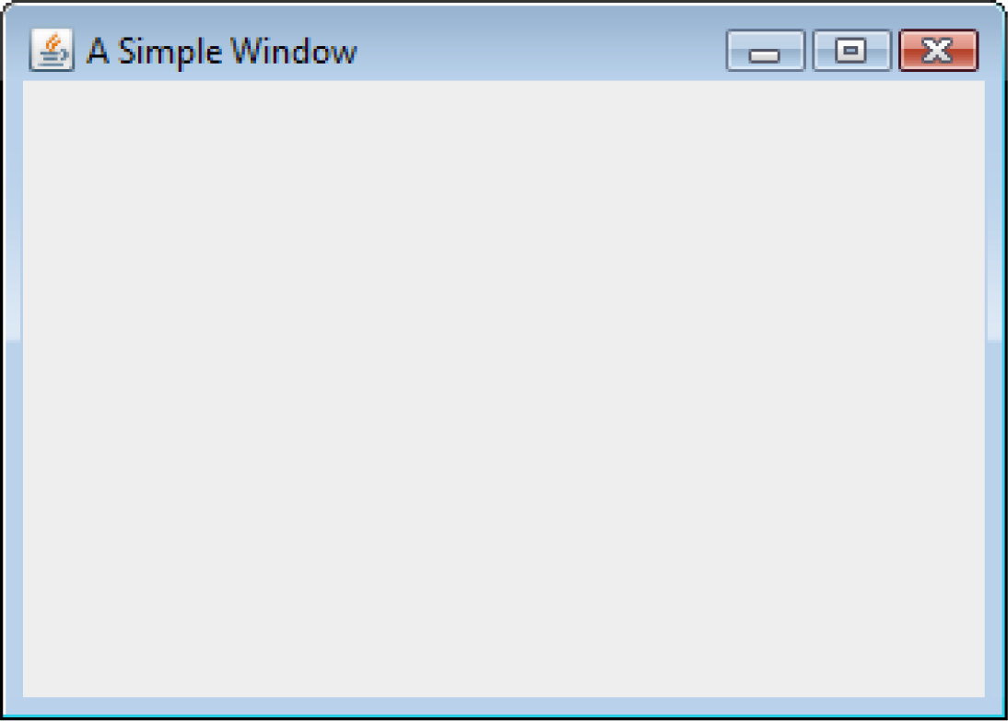
Creating Windows
See example: ShowWindow.java

Slide 15
Creating Windows
The following import statement is needed to use the swing components:
import javax.swing.*;
In the main method, two constants are declared:
final int WINDOW_WIDTH = 350;
final int WINDOW_HEIGHT = 250;
We use these constants later in the program to set the size of the window.
The window’s size is measured in pixels.
A pixel (picture element) is one of the small dots that make up a screen display.

Slide 16
Creating Windows
An instance of the JFrame class needs to be created:
JFrame window = new JFrame();
This statement:
creates a JFrame object in memory and
assigns its address to the window variable.
The string that is passed to the setTitle method will appear in the window’s title bar when it is displayed.
window.setTitle("A Simple Window");
A JFrame is initially invisible.

Slide 17
Creating Windows
To set the size of the window:
window.setSize(WINDOW_WIDTH, WINDOW_HEIGHT);
To specify the action to take place when the user clicks on the close button.
window.setDefaultCloseOperation(JFrame.EXIT_ON_CLOSE);
The setDefaultCloseOperation method takes an int argument which specifies the action.
JFrame.HIDE_ON_CLOSE - causes the window to be hidden from view, but the application does not end.
The default action is JFrame.HIDE_ON_CLOSE.

Slide 18
Creating Windows
The following code displays the window:
window.setVisible(true);
The setVisible method takes a boolean argument.
true - display the window.
false - hide the window.

Slide 19
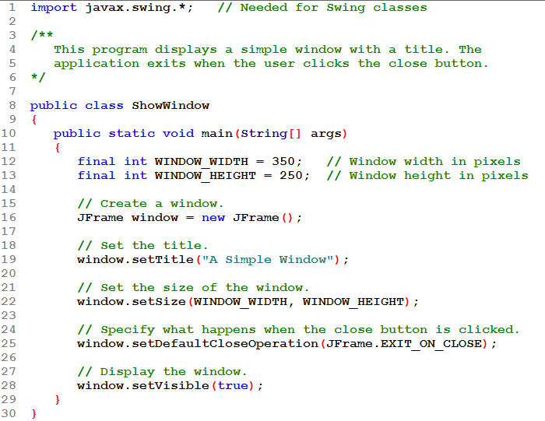
Creates the JFrame and uses its methods to set its title, size.
Without the close operation being set as shown, the app won't end when the window is closed.
The window is invisible by default. So the setVisible() method is used to make it visible!

Slide 20
This is an application: we write main() which creates the JFrame.
We can see from the way methods are called that all 4 methods must be members of the JFrame class.

Slide 21
Extending JFrame
Instead of directly creating a JFrame it is usual to use inheritance to create a new class that extends the JFrame class.
This is done with a class header like this:
public class SimpleWindow extends JFrame
The word extends used here means that our new class, SimpleWindow, is to be a "subclass" of JFrame.

Slide 22
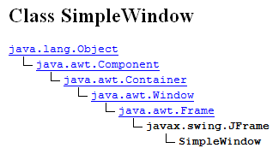
Class SimpleWindow

Slide 23
Extending JFrame
When a new class (SimpleWindow) extends an existing class (JFrame), it inherits many of the existing class’s members just as if they were part of the new class.
These members act just as if they were written into the new class declaration.
Inherited methods we are using are:
setTitle()
setSize()
setDefaultCloseOperation()
setVisible()

Slide 24
Extending JFrame
New fields and methods can be declared in the new class declaration.
This allows specialized methods and fields to be added to your window.
Typically, extending a class means that we add fields and /or methods to those that were inherited.
We cannot remove fields or methods!
In this example we are not adding any new fields or methods.
We are simply using the SimpleWindow class's constructor to specify what the new class's windows look like.
Examples: SimpleWindow.java, SimpleWindowDemo.java

Slide 25
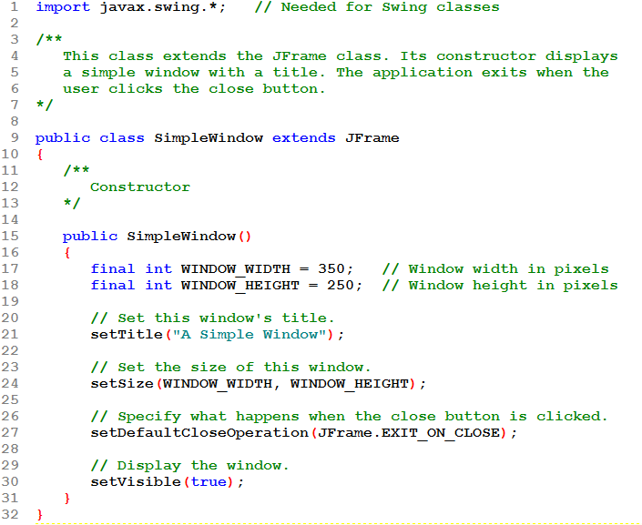
This is a class that can be used to create a SimpleWindow.
A SimpleWindow is a type of JFrame.
The constructor for this class invokes JFrame methods (inherited into the SimpleWindow class) to customize the window.
There's no main() here: this is not an application class so we can't run it. We need a client to create an instance of SimpleWindow.

Slide 26
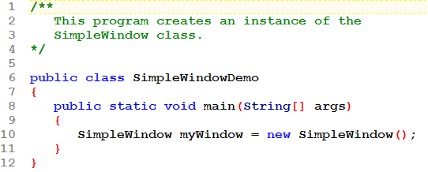
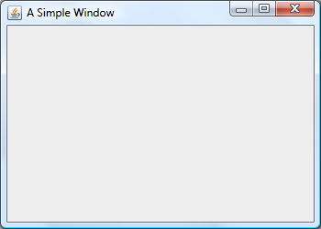
This is the application: the client that will actually create the SimpleWindow object.
In this example, main() creates an instance of the SimpleWindow class. This has the effect of opening an actual SimpleWindow and displaying it for the user to see.

Slide 27
Adding Components
Swing provides numerous components that can be added to a window.
Three fundamental components are:
JLabel : An area that can display text.
JTextField : An area in which the user may type a single line of input from the keyboard.
JButton : A button that can cause an action to occur when it is clicked.

Slide 28
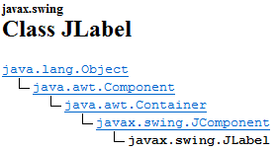
Class JLabel

Slide 29
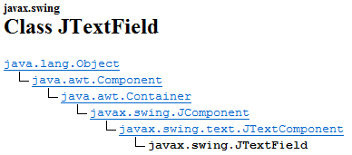
Class JTextField

Slide 30
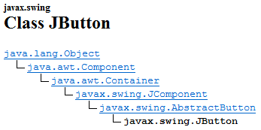
Class JButton

Slide 31
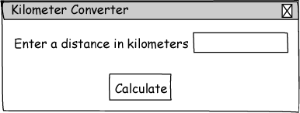
Sketch of Kilometer Converter Graphical User Interface
Text Field
Window Title
Label
Button

Slide 32
Adding Components
private JLabel message;
private JTextField kilometers;
private JButton calcButton;
…
message = new JLabel(
"Enter a distance in kilometers");
kilometers = new JTextField(10);
calcButton = new JButton("Calculate");
This code declares and instantiates three Swing components.

Slide 33
Adding Components: content panes
A content pane is a container that is part of every JFrame object.
To display a component in a JFrame you add that component to the JFrame's content pane. You do this with the JFrame class's add method.
The content pane is not visible and it does not have a border.

Slide 34
Adding Components: panels
A panel is also a container that can hold GUI components.
Panels cannot be displayed by themselves.
Panels are commonly used to hold and organize collections of related components.
Create panels with the JPanel class.
private JPanel panel;
…
panel = new JPanel();
panel.add(message);
panel.add(kilometers);
panel.add(calcButton);

Slide 35
Adding Components
Components are typically placed on a panel and then the panel is added to the JFrame's content pane.
add(panel);
Examples: KiloConverterWindow.java, KilometerConverterDemo.java

Slide 36
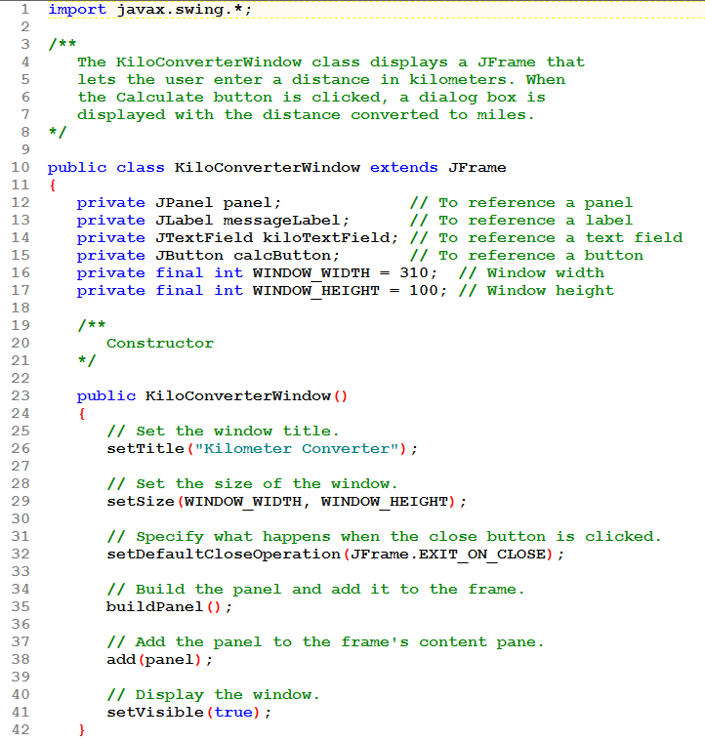
Constructor sets the window's title, etc.
Method buildPanel() is used to put GUI components onto a panel.
add(panel); will add that panel to the window's content pane.
Note that the GUI components and the constants are all declared as fields in this class. We'll see why later.

Slide 37
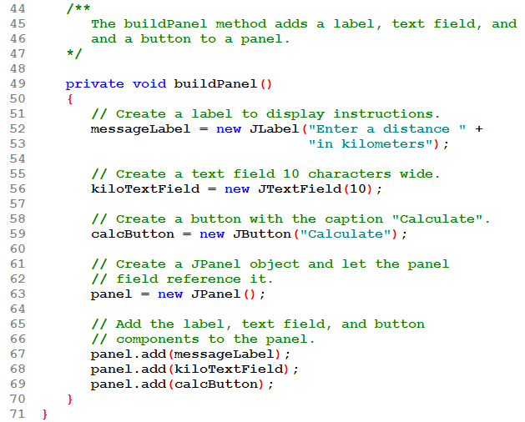
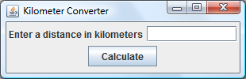
The buildPanel() method creates each GUI component. Then creates a panel and adds the GUI components to the panel.
When done, the panel is ready to be added to the content pane.
There are 2 different add methods being used: one that is a JPanel method (line 67), used to add components to the panel and one that is a JFrame method (line 38), used to add the panel to the frame's content pane.

Slide 38
The buildPanel() method creates each GUI component. Then creates a panel and adds the GUI components to the panel.
When done, the panel is ready to be added to the content pane.
Note that buildPanel() is private. It can only be called by other methods in this class, not by the client!

Slide 39
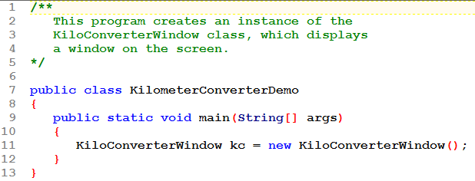
The application that creates the KiloConverterWindow
Unfortunately, that's all the happens! The window is created and looks pretty enough, but it doesn't DO anything!
We need to add code to the program so that clicking on that Calculate button gets us a calculation and shows us the result!

Slide 40
Handling Action Events
So how does the program know what to do when the user clicks the Calculate button?
This is what an event handler is for.
An event is an action that takes place within a program, such as the clicking of a button.
When an event takes place, the component that is responsible for the event creates an event object in memory.
The event object contains information about the event.
Such as the event source, the event location, and more.

Slide 41
Handling Action Events
The component that generated the event object is known as the event source. (Ex: the Calculate button)
An event listener is an object that responds to events.
There are several types of listeners. For example, there is a type of listener that "listens for" button clicks, one that "listens for" mouse activity, one that "listens for" choices from checkboxes or radio buttons, and many more
If the event source is connected to an event listener, then the event object that is created when the event occurs is automatically passed, as an argument, to a specific method in the listener.

Slide 42
Handling Action Events
Event
Object
JButton Component
Action Listener Object
void actionPerformed(ActionEvent e)
When the button is pressed …
The JButton component generates an event object and passes it to the action listener object's actionPerformed method.

Slide 43
Handling Action Events
Our job is to
Write the event listener class(es) that our application needs
Connect the source to the listener by a process referred to as "registering" the listener.
Event listener classes are customized for each application.
Event listener classes are commonly written as private inner classes in an application.
It is possible that the source component is connected to more than one event listener.

Slide 44
Writing Event Listener Classes as Private Inner Classes
A class that is defined inside of another class is known as an inner class.
A private class (like Inner) can be used only by the class it is defined within (Outer).
public class Outer
{
Fields and methods of the Outer class appear here.
private class Inner
{
Fields and methods of the Inner class appear here.
}
}

Slide 45
Event Listeners Must Implement an Interface
All event listener classes must implement an interface.
An interface is something like a class.
It specifies certain method headers that your customized listener must then include.
When you write a class that implements an interface, you are agreeing that the class will have all of the methods that are specified in the interface.
There are many different interfaces to use with event listeners. The one you implement depends on the type of event you need to handle.

Slide 46
Event Listeners Must Implement an Interface
The JButton component generates an action event object.
To handle its events, we will need to include an action listener.
An action listener must implement the ActionListener interface. Here is what the ActionListener interface looks like:
public interface ActionListener
{
public void actionPerformed( ActionEvent e);
}

Slide 47
Event Listeners Must Implement an Interface
We can see from its interface, that we must write the actionPerformed()method. The header of our method must exactly match the header as specified in the interface.
The actionPerformed method takes an argument of the ActionEvent type.
public void actionPerformed(ActionEvent e)
{
Code to be executed when button is pressed goes here.
}

Slide 48
Handling Action Events
Event
Object
JButton Component
Action Listener Object
void actionPerformed(ActionEvent e)
When the button is pressed …
The JButton component generates an event object and passes it to the action listener object's actionPerformed method.
Examples:
KiloConverterWindow.java, KilometerConverterDemo.java

Slide 49
Registering A Listener
The process of connecting an event listener object to a component is called registering the event listener.
JButton components have a method named addActionListener.
calcButton.addActionListener(
new CalcButtonListener());
When the user clicks on the source button, the action listener object’s actionPerformed method will be executed.

Slide 50
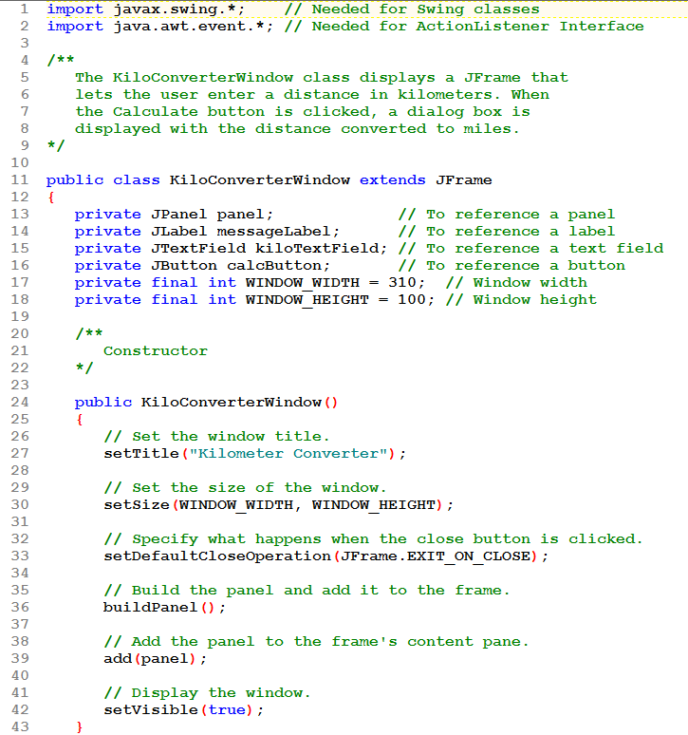
Note we need to import a new package to gain access to the event listener classes:
import java.awt.event.*;
Otherwise, the constructor is not changed from the earlier version of the KiloConverter.

Slide 51
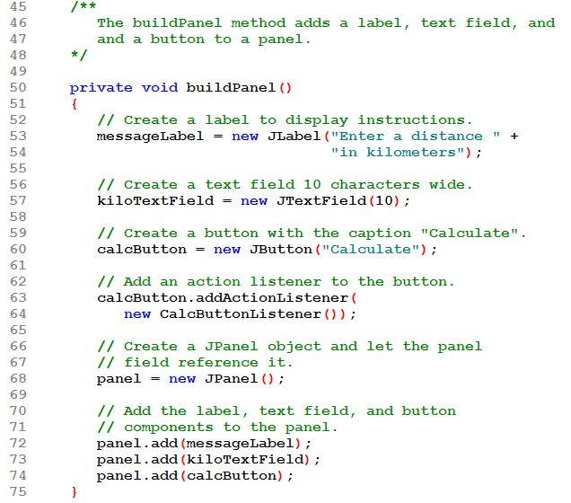
The buildPanel() method has just one change: an action listener is added to the calculate button.
It is this listener object's actionPerformed() method that will be called when the user clicks the calculate button.

Slide 52
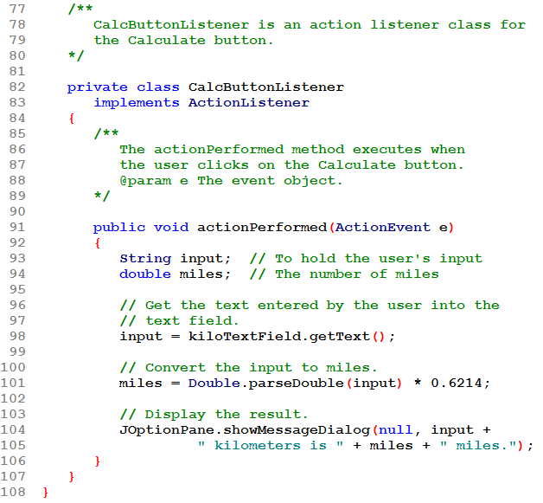
Note the header for the new inner class:
private so only the outer class can use it.
CalcButtonListener the name can be any descriptive name
implements ActionListener so it must include the required actionPerformed() method.

Slide 53
The actionPerformed() method is where we place the code we can to run when the user clicks the calculate button.
It can have its own local variables (such as input and miles).
It has access to the fields of the outer class (such as kiloTextField)

Slide 54
The actionPerformed() method is where we place the code we can to run when the user clicks the calculate button.
It can have its own local variables (such as input and miles).
It has access to the fields of the outer class (such as kiloTextField)
Line 98: a JTextField object (kiloTextField) has a getText() method that can be used to return the current text in the textfield.

Slide 55
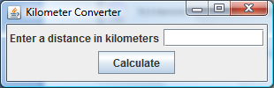
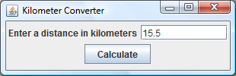
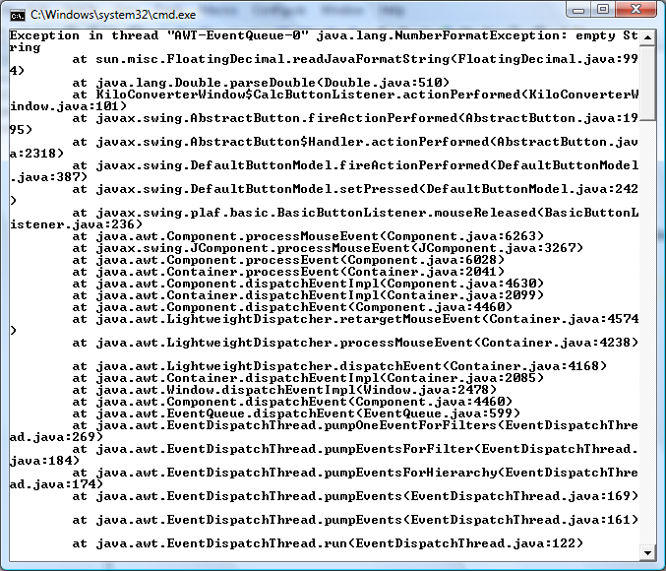
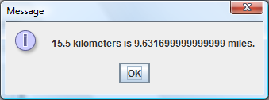
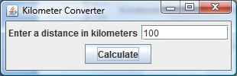
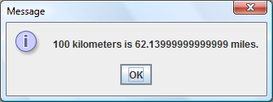
Dealing with an empty JTextField might be necessary!

Slide 56
Validating Data in a TextField
With event-driven programming, handling invalid input is usually done like this:
Read the value
If it's not valid, display a message
Otherwise, process as usual
There is no need to loop: the user will be presented with the error message and then the system will wait for the user to decide what to do next.

Slide 57
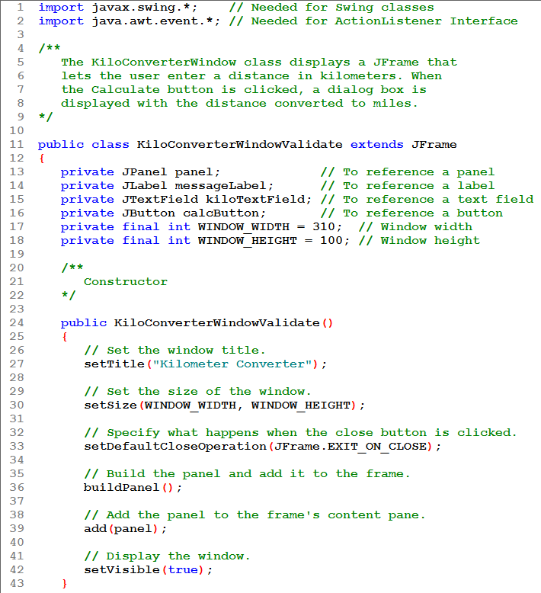
This version of KiloConverter will validate user input. The constructor and buildPanel() methods are not changed. The buildPanel() method is not shown.

Slide 58
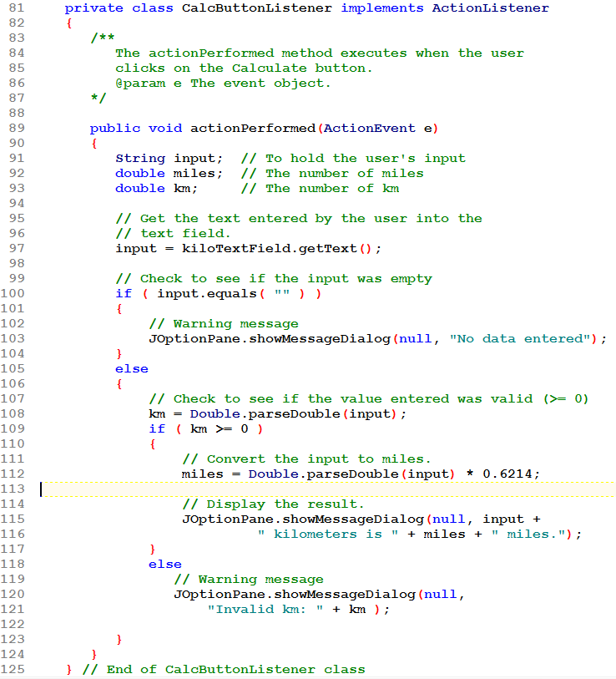
The actionPerformed method is called when the user clicks the button.
If the textfield is empty, a warning message is given.
If the value in the textfield is negative a warning message is given.
Notice there is no loop here!

Slide 59
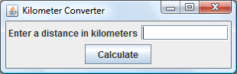
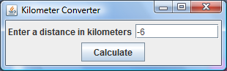
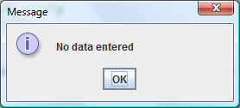
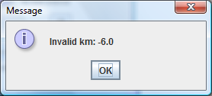
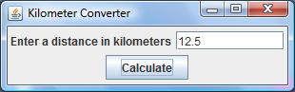
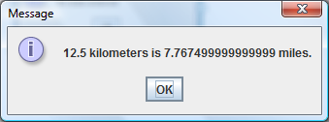
Once the warning message has been displayed and the user has clicked OK, the input dialog is again visible and the user can decide to either enter another value or click the X to close the program.

Slide 60
Background and Foreground Colors
Many of the Swing component classes have methods named setBackground and setForeground.
setBackground is used to change the color of the component itself.
setForeground is used to change the color of the text displayed on the component.
Each method takes a color constant as an argument.

Slide 61
Color Constants
There are predefined constants that you can use for colors.
Color.BLACK Color.BLUE
Color.CYAN Color.DARK_GRAY
Color.GRAY Color.GREEN
Color.LIGHT_GRAY Color.MAGENTA
Color.ORANGE Color.PINK
Color.RED Color.WHITE
Color.YELLOW

Slide 62
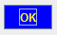
Color Constants
Example:
JButton okButton = new JButton("OK");
okButton.setBackground(Color.BLUE);
okButton.setForeground(Color.YELLOW);
The button will be blue; the text will be yellow.
Examples: ColorWindow.java, ColorDemo.java

Slide 63
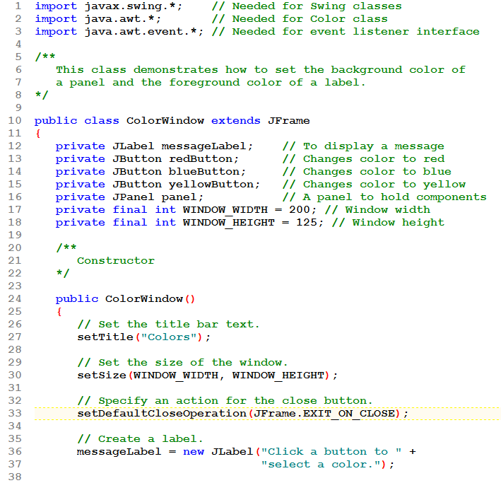
To use colors, you must import java.awt;
Three JButtons are declared.

Slide 64
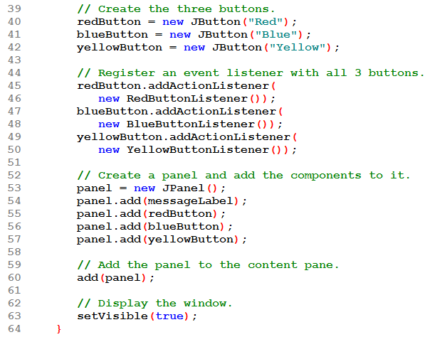
The buttons are created (red arrow) and then listeners are added to each (blue arrow).

Slide 65
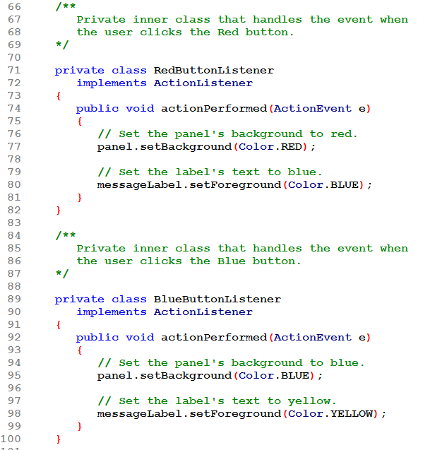
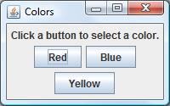
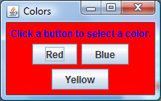
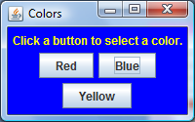
There is a different inner class (i.e. a different listener) for each button.

Slide 66
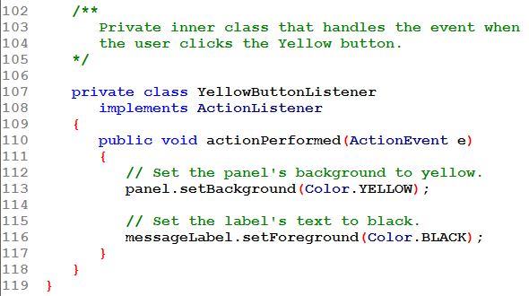
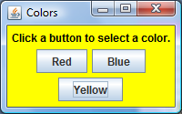
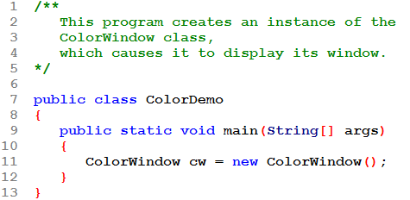
This is the application that creates the instance of our ColorWindow

Slide 67
To Set the Background Color of the JFrame's Content Pane
The way we are adding components in these examples is to add them to a JPanel and then add the JPanel to the JFrame's content pane. The JPanel covers the entire content pane.
So the JPanel's color is what we see inside the frame.
In other applications, we may wind up with components that don't cover the entire content pane. If you want to change the background color of the content pane itself, this is how you would do it:
getContentPane().setBackground(Color.RED);
Note that you are not changing the JFrame's background color. Since the content pane covers it, you won't see it anyway!
setBackground(Color.RED); // Frame's backgd

Slide 68
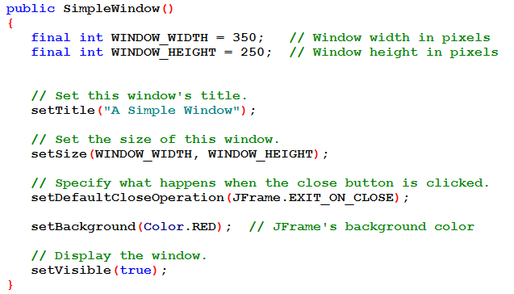
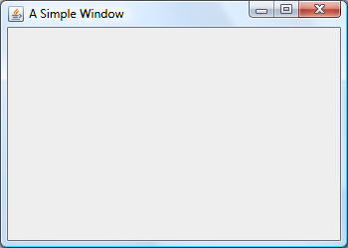
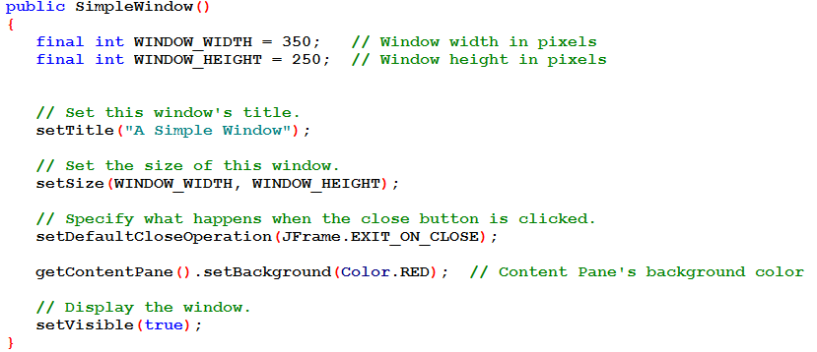
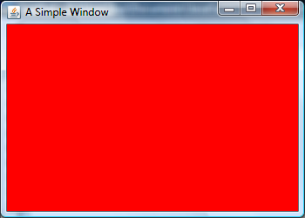

Slide 69
The ActionEvent Object
Event objects contain certain information about the event.
When actionPerformed() is called, an ActionEvent object is passed to it as a parameter.
We can get information about the event by calling methods for the event object.
Recall that this is the header for actionPerformed():
public void actionPerformed(ActionEvent e)

Slide 70
The ActionEvent Object: getActionCommand()
The getActionCommand() method returns the action command that is associated with the event.
This return item is different, depending on the type of component.
For a button, it returns the text that appears on the button.
You could use this to determine which button was clicked if several buttons share the same action listener class.
See the next example, where e.getActionCommand() returns the text on the button that the user clicked.
Example:
EventObjectWindow.java, EventObjectDemo.java

Slide 71
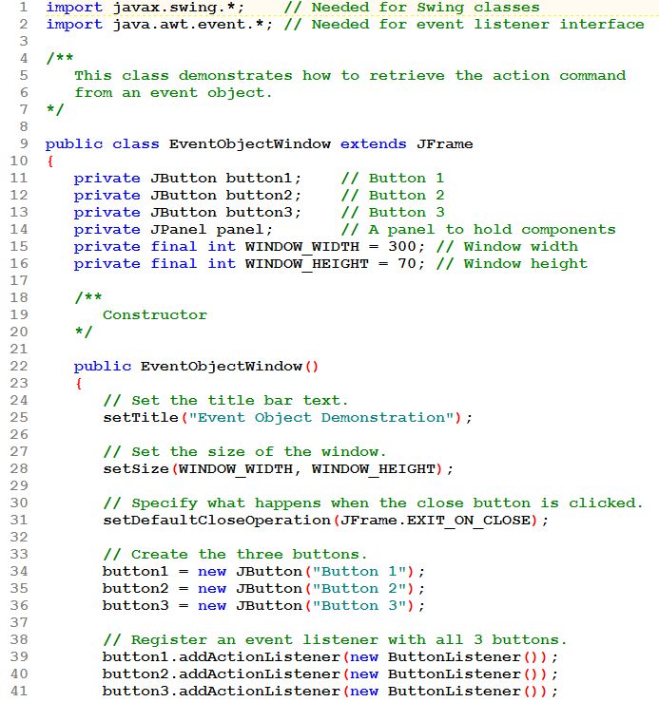
Declare 3 JButtons.
Make them say different things.
Add the same type listener to each. But each has its own listener object.

Slide 72
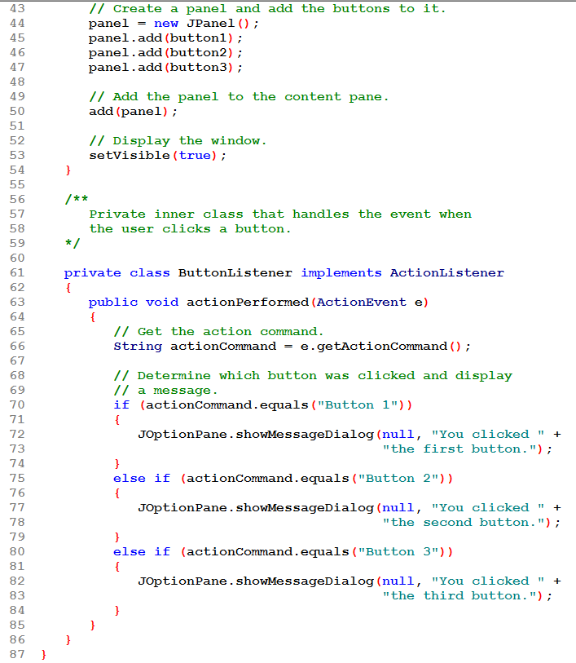
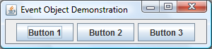

The ButtonListener class uses the actionCommand() value to decide which button was clicked and display the correct message.

Slide 73
The ActionEvent Object: getSource()
The getSource() method returns a reference to the object that generated the event.
This provides an alternate way to determine which component generated the event.
See the next example, where e.getSource() returns a reference to the object that the user clicked.
It is exactly the same as the previous example, but the actionPerformed() method is rewritten to use e.getSource() rather than e.getActionCommand().

Slide 74



The ButtonListener class uses the getSource() value to decide which button was clicked and display the correct message.

Slide 75
Equipping GUI Classes with a main Method
Java applications always starts execution with a method named main.
We have seen applications in two separate files, one file for the class that defines the GUI window and one file that contains the main method that creates an object of the GUI window class.
Applications can also be written with the main method directly written into the GUI class.
See example: EmbeddedMain.java

Slide 76


The EmbeddedMain class has its own main() method.
Notice that main() has the same header and looks just like it has in the past.
main() creates an instance of EmbeddedMain and that's all!

Slide 77
Using Console Output to Debug a GUI
If your GUI application is not running correctly, you may want to display variable values, etc. to identify logic errors.
Use System.out.println()
// For debugging, display the text entered, and
// its value converted to a double.
System.out.println("Reading " + str +
" from the text field.");
System.out.println("Converted value: " +
Double.parseDouble(str));

Slide 78
Using Console Output to Debug a GUI
These messages are for the programmer, not the user, to see.
Once the program is completely debugged, these lines should be removed!
Example: the KiloConverter program, where the ActionPerformed() method has had some debugging code inserted. Otherwise, the program is the same as seen previously.
See example: KiloConverterWindow.java

Slide 79

Diagnostic use of println() to show the programmer what the user input was and how it converted to double.
More diagnostic use to show that the end of actionPerformed() was reached and the program is ready for more user input.

Slide 80







Execution begins. The app window shows up.
User enters a value and clicks Calculate. Diagnostic output appears on the console. Message dialog shows answer.
User clears the message dialog.
More output on the console.
The app window is ready for another input.

Slide 81
END chapter 7-1

Slide 82
Layout Managers
An important part of designing a GUI application is determining the layout of the components.
The term layout refers to the positioning and sizing of components.
In Java, you do not normally specify the exact location of a component within a window.
A layout manager is an object that:
controls the positions and sizes of components, and
makes adjustments when necessary.

Slide 83
Layout Managers
The layout manager object and the container work together.
Java provides several layout managers:
FlowLayout - Arranges components in rows. This is the default for panels.
BorderLayout - Arranges components in five regions:
North, South, East, West, and Center.
This is the default layout manager for a JFrame object’s content pane.
GridLayout - Arranges components in a grid with rows and columns.

Slide 84
Layout Managers
The Container class is one of the base classes that many components are derived from.
Any component that is derived from the Container class can have a layout manager added to it.
You add a layout manager to a container by calling the setLayout method.
JPanel panel = new JPanel();
panel.setLayout(new BorderLayout());
In a JFrame constructor you might use: setLayout(new FlowLayout());

Slide 85
FlowLayout Manager
FlowLayout is the default layout manager for JPanel objects.
Components appear horizontally, from left to right, in the order that they were added. When there is no more room in a row, the next components “flow” to the next row.
See example: FlowWindow.java

Slide 86




Now it's the JFrame that we are adding buttons to using FlowLayout.
Notice that if we pull the edges of the window to change its shape, the buttons move.
Also notice that the buttons are centered in the window.
NOTE: main() is omitted here to save space.

Slide 87
FlowLayout Manager
The FlowLayout manager allows you to align components:
in the center of each row
along the left or right edges of each row.
An overloaded constructor allows you to pass:
FlowLayout.CENTER, // the default
FlowLayout.LEFT, or
FlowLayout.RIGHT.
Example:
setLayout(new FlowLayout(FlowLayout.LEFT));

Slide 88




Now the buttons are left-aligned in the window.

Slide 89
FlowLayout Manager
FlowLayout inserts a gap of five pixels between components, horizontally and vertically.
An overloaded FlowLayout constructor allows these to be adjusted.
The constructor has the following format:
FlowLayout(int alignment,
int horizontalGap,
int verticalGap)
Example: setLayout(new FlowLayout(FlowLayout.LEFT, 20, 12));

Slide 90


See how the spacing between buttons compares to the previous example:
In the first window there is a 5 pixel horizontal and vertical spacing.
In the second there is a 20 pixel horizontal spacing and 12 pixels vertically.

Slide 91

BorderLayout Manager
BorderLayout manages five regions where components can be placed.

Slide 92
BorderLayout Manager
See example: BorderWindow.java
A component placed into a container that is managed by a BorderLayout must be placed into one of five regions:
BorderLayout.NORTH
BorderLayout.SOUTH
BorderLayout.EAST
BorderLayout.WEST
BorderLayout.CENTER

Slide 93
BorderLayout Manager
Each region can hold only one component at a time.
When a component is added to a region, it is stretched so it fills up the entire region.
BorderLayout is the default manager for JFrame objects.
add(button, BorderLayout.NORTH);
If you do not pass a second argument to the add method, the component will be added to the center region.

Slide 94


One component can be added to each of the 5 areas of a BorderLayout.
If an area doesn't have a component added to it, its "turf" is given over to adjacent area(s). See the next slide.
NOTE: main() is omitted here to save space.

Slide 95






See the effect of adding buttons to some, but not all, of the areas of the BorderLayout.

Slide 96
BorderLayout Manager
Normally the size of a button is just large enough to accommodate the text that it displays
The buttons displayed in BorderLayout region will not retain their normal size.
The components are stretched to fill all of the space in their regions.

Slide 97
BorderLayout Manager
If the user resizes the window, the sizes of the components will be changed as well.
BorderLayout manager resizes components:
placed in the north or south regions may be resized horizontally so it fills up the entire region,
placed in the east or west regions may be resized vertically so it fills up the entire region.
A component that is placed in the center region may be resized both horizontally and vertically so it fills up the entire region.

Slide 98
BorderLayout Manager
By default there is no gap between the regions.
An overloaded BorderLayout constructor allows horizontal and vertical gaps to be specified (in pixels).
The constructor has the following format
BorderLayout(int horizontalGap, int verticalGap)
Example:
setLayout(new BorderLayout(5,10));

Slide 99


Now there is a gap between components: horizontal gap of 5 pixels, vertical gap of 10 pixels.

Slide 100

Add an array of buttons to a BorderLayout.
Add an ActionListener to each button.
The ActionListener class is "this" class!

Slide 101

Instead of calling the setSize() method, this program uses the Frame class's pack() method. Call it just before making the window visible, and it will automatically size the window to hold its components. Comment it out and see what happens!

Slide 102




When a button is clicked, set its visibility to false; set the other buttons' visibility to true.
Call the validate() method to force the content pane to be redisplayed.

Slide 103
Nesting Components in a Layout
Adding components to panels and then nesting the panels inside the regions can overcome the single component limitation of layout regions.
It can also overcome the limitation that components will be resized to fill the region.
By adding buttons to a JPanel and then adding the JPanel object to a region, sophisticated layouts can be achieved.

Slide 104
Nesting Components in a Layout
In the next program, we will see that we can get the buttons to retain their original size by adding each to its own panel, and then adding the panels to the BorderLayout.

Slide 105
Nesting Components in a Layout
This example doesn't size the window the same way earlier examples did (using setSize()).
Instead it uses the JFrame's pack() method.
Call it after adding all the components, just before making the frame visible. It will automatically size the window to hold its components.
See example:BorderPanelWindow.java

Slide 106


Each button is added to its own panel.
Each panel is added to an area of the frame.
NOTE: only the constructor is shown here to save space.

Slide 107
Nesting Components in a Layout
The BorderLayout resizes the JPanels to fit the areas, not the buttons contained in the panels.
This example has
a JFrame using BorderLayout
Components are added to each area of the frame
several JPanels using FlowLayout
Buttons are added to the panel in flow layout style: they are centered in the panel.

Slide 108
GridLayout Manager
GridLayout creates a grid with rows and columns, much like a spreadsheet. A container that is managed by a GridLayout object is divided into equally sized cells.
columns
rows

Slide 109
GridLayout Manager
GridLayout manager follows some simple rules:
Each cell can hold only one component.
All of the cells are the size of the largest component placed within the layout.
A component that is placed in a cell is automatically resized to fill up any extra space.
You pass the number of rows and columns as arguments to the GridLayout constructor.

Slide 110
GridLayout Manager
The general format of the constructor:
GridLayout(int rows, int columns)
Example
setLayout(new GridLayout(2, 3));
A zero (0) can be passed for one of the arguments but not both. It will be treated as if there were a 1 in that position.
passing 0 for both arguments will cause an IllegalArgumentException to be thrown.

Slide 111
GridLayout Manager
Components are added to a GridLayout in the following order (for a 5×5 grid):
To leave a cell "empty" you must put something invisible in it, like a JLabel with no text.
1
2
3
4
5
6
7
8
9
10
11
12
13
14
15
16
17
18
19
20
21
22
23
24
25

Slide 112


Create 6 buttons and add them to the grid.
They will add going across a row, then down to the next row, etc.

Slide 113

Create 2 different grid layouts:
2 rows x 3 cols
3 rows x 2 cols
Use one of them to layout the content pane.
Add an array of buttons to a content pane using a GridLayout.
Add an ActionListener to each button.
The ActionListener class is "this" class!

Slide 114



When a button is clicked, switch to the other layout manager.
Call the validate() method to force the content pane to be redisplayed.
Comment it out and see what happens!

Slide 115
GridLayout Manager
GridLayout also accepts nested components.
As with the BorderLayout, components can be added to panels which are then added to the grid.
In the example that follows, this allows us to add both a JLabel and a JButton to each cell in the grid.
Example: GridPanelWindow.java

Slide 116

This time we will add a panel to each cell in the grid.
Establish a grid layout.
Then create 6 buttons.

Slide 117


Create 6 labels.
Create 6 panels.
Add a label to each panel.
Add a button to each panel.
** Panels are using FlowLayout.
Add the panels to the grid.

Slide 118
END chapter 7-2

Slide 119
Radio Buttons
Radio buttons allow the user to select one choice from several possible options.
The JRadioButton class is used to create radio buttons.
JRadioButton constructors:
JRadioButton(String text)
JRadioButton(String text, boolean selected)
Example:
JRadioButton radio1 = new JRadioButton("Choice 1");
or
JRadioButton radio1 = new JRadioButton(
"Choice 1", true);
Button appears already selected when true

Slide 120
Button Groups
Radio buttons normally are grouped together.
In a radio button group only one of the radio buttons in the group may be selected at any time.
Clicking on a radio button selects it and automatically deselects any other radio button in the same group.
An instance of the ButtonGroup class is a used to group radio buttons

Slide 121
Button Groups
The ButtonGroup object creates the mutually exclusive relationship between the radio buttons that it contains.
JRadioButton radio1 = new JRadioButton("Choice 1",
true);
JRadioButton radio2 = new JRadioButton("Choice 2");
JRadioButton radio3 = new JRadioButton("Choice 3");
ButtonGroup group = new ButtonGroup();
group.add(radio1);
group.add(radio2);
group.add(radio3);

Slide 122
Button Groups
ButtonGroup objects are not containers like JPanel objects, or content frames.
If you wish to add the radio buttons to a panel or a content frame, you must add them individually.
panel.add(radio1);
panel.add(radio2);
panel.add(radio3);

Slide 123

Class ButtonGroup

Slide 124
Radio Button Events
JRadioButton objects generate an action event when they are clicked.
To respond to an action event, you must write an action listener class, just like a JButton event handler.
See example: MetricConverterWindow.java

Slide 125

Class JRadioButton

Slide 126



The same type of setup as in our earlier GUI classes.

Slide 127

Create the component objects.
Put the radio buttons into a group.
Add a listener to each radio button.
There are 3 separate listeners, but all are the same type: RadioButtonListener.
Put components onto the panel.

Slide 128

Check the source of the event using e.getSource().
Each source has its own text and result.
After determining the text and result, put them into the message dialog.

Slide 129
Determining Selected Radio Buttons
The JRadioButton class’s isSelected method returns a boolean value indicating if the radio button is selected.
if (radio.isSelected())
{
// Code here executes if the radio
// button is selected.
}

Slide 130

The same type of setup as in our earlier GUI classes.

Slide 131

Create some Font objects.
Create the component objects.
Put components onto the panel.
Put the radio buttons into a group.
This time we create just one button handler. Use it to handle all of the radio buttons.

Slide 132





Uses the radio button's isSelected() method to determine which button is currently selected and sets the text field's font accordingly.

Slide 133
Selecting a Radio Button in Code
It is also possible to select a radio button in code with the JRadioButton class’s doClick method.
When the method is called, the radio button is selected just as if the user had clicked on it.
As a result, an action event is generated and its listener is notified.
radio.doClick();

Slide 134
Check Boxes
A check box appears as a small box with a label appearing next to it.
Like radio buttons, check boxes may be selected or deselected at run time.
When a check box is selected, a small check mark appears inside the box.
Check boxes are often displayed in groups but they are not usually grouped in a ButtonGroup.

Slide 135

Class JCheckBox

Slide 136
Check Boxes
The user is allowed to select any or all of the check boxes that are displayed in a group.
The JCheckBox class is used to create check boxes.
Two JCheckBox constructors:
JCheckBox(String text)
JCheckBox(String text, boolean selected)
Example:
JCheckBox check1 = new JCheckBox("Macaroni");
or
JCheckBox check1 = new JCheckBox("Macaroni",
true);
Check appears in box if true

Slide 137
Check Box Events
When a JCheckBox object is selected or deselected, it generates an item event.
Handling item events is similar to handling action events.
Write an item listener class, which must meet the following requirements:
It must implement the ItemListener interface.
It must have a method named itemStateChanged.
This method must take an argument of the ItemEvent type.
public void itemStateChanged(ItemEvent e)

Slide 138
Check Box Events
Create an object of the class
Register the item listener object with the JCheckBox component.
On an event, the itemStateChanged method of the item listener object is automatically run
The event object is passed in as an argument.

Slide 139
Determining Selected Check Boxes
The isSelected method will determine whether a JCheckBox component is selected.
The method returns a boolean value.
if (checkBox.isSelected())
{
// Code here executes if the check
// box is selected.
}
See example: ColorCheckBoxWindow.java

Slide 140

The same type of setup as in our earlier GUI classes.
Create the checkboxes and add an ItemListener to each.

Slide 141

Set the Frame's layout manager to FlowLayout. Add the label and checkboxes directly to the content pane rather than to a panel.
If the yellow checkbox is the source, it was either being checked or cleared.
If it was being checked set the background of the content pane and check boxes to yellow
If it was being cleared, set the backgrounds to light gray.

Slide 142





If the red checkbox is the source, it was either being checked or cleared.
If it was being checked set the foreground of the content pane and check boxes to red
If it was being cleared, set the foregrounds to black

Slide 143

The same type of setup as in our earlier GUI classes.

Slide 144

Create a handler and use the same handler for both check boxes.
If the bold box was clicked, then valBold will be set: to BOLD if the box was selected, to PLAIN if the box was cleared.
If the italic box was clicked, then valItalic will be set: to ITALIC if the box was selected, to PLAIN if the box was cleared.
Set the font for the text field to valBold + valItalic.

Slide 145






Slide 146
Selecting Check Boxes in Code
It is possible to select check boxes in code with the JCheckBox class’s doClick method.
When the method is called, the check box is selected just as if the user had clicked on it.
As a result, an item event is generated.
checkBox.doClick();

Slide 147


Borders
Windows have a more organized look if related components are grouped inside borders.
You can add a border to any component that is derived from the JComponent class.
Any component derived from JComponent inherits a method named setBorder

Slide 148
Borders
The setBorder method is used to add a border to the component.
The setBorder method accepts a Border object as its argument.
A Border object contains detailed information describing the appearance of a border.
The BorderFactory class, which is part of the javax.swing package, has static methods that return various types of borders.
p.setBorder(BorderFactory.create...Border(...));

Slide 149
Border | BorderFactory Method | Description
Compound border | createCompoundBorder | A border that has two parts: an inside edge and an outside edge. The inside and outside edges can be any of the other borders.
Empty border | createEmptyBorder | A border that contains only empty space.
Etched border | createEtchedBorder | A border with a 3D appearance that looks “etched” into the background.
Line border | createLineBorder | A border that appears as a line.
Lowered bevel border | createLoweredBevelBorder | A border that looks like beveled edges. It has a 3D appearance that gives the illusion of being sunken into the surrounding background.
Matte border | createMatteBorder | A line border that can have edges of different thicknesses.
Raised bevel border | createRaisedBevelBorder | A border that looks like beveled edges. It has a 3D appearance that gives the illusion of being raised above the surrounding background.
Titled border | createTitledBorder | An etched border with a title.

Slide 150

This app will create buttons with different types of borders.

Slide 151



Slide 152

The panels that contain the buttons are themselves added to a "master" panel with grid layout.
The master panel has a compound border.
To make the master panel more visible, it is added to the center of the content pane and empty panels are added to the other regions.

Slide 153
Borders: Empty Borders
An empty border is simply empty space around the edges of a component.
Arguments are pixels.
General form:
BorderFactory.createEmptyBorder(int top, int left,
int bottom, int right);
Example:
JPanel p = new JPanel();
p.setBorder(BorderFactory.createEmptyBorder(
5, 10, 15, 20));

Slide 154
Borders: Line Borders
A line border is a line of a specified color and thickness around the edges of a component.
General form:
BorderFactory.createLineBorder(Color c, int thickness);
Example:
JPanel p = new JPanel();
p.setBorder(BorderFactory.createLineBorder(
Color.RED, 5));
// Red border, 5 pixels thick

Slide 155
Borders: Etched Borders
An etched border has a raised/lowered line around the edges of a component.
General form:
BorderFactory.createEtchedBorder(
EtchedBorder.RAISED); // or LOWERED
Example:
JPanel p = new JPanel();
p.setBorder(BorderFactory.createEtchedBorder(
EtchedBorder.LOWERED));
// Lowered etched border

Slide 156
Borders: Titled Borders
A titled border is an etched border with a title displayed on it around the edges of a component.
General form:
BorderFactory.createTitledBorder(String str);
Example:
JPanel p = new JPanel();
p.setBorder(BorderFactory.createTitledBorder(
"Choices"));
// Etched border that says "Choices"

Slide 157
Borders: Matte Borders
A matte border is a lined border that can have edges of different thicknesses.
General form:
BorderFactory.createMatteBorder(int top, int left,
int bottom, int right, Color c)
Example:
JPanel p = new JPanel();
p.setBorder(BorderFactory.createMatteBorder(
2, 4, 6, 8, Color.RED));

Slide 158
Borders: Bevel Borders
A bevel border can have either a raised or lowered bevel around the edges of a component.
General form:
BorderFactory.createRaisedBevelBorder();
BorderFactory.createLoweredBevelBorder();
Example:
JPanel p = new JPanel();
p.setBorder(BorderFactory.createLoweredBevelBorder();

Slide 159
Borders: Compound Borders
A compound border has two parts: the outside edge and the inside edge. Each edge can be any type of border.
General form:
BorderFactory.createCompoundBorder(
BorderFactory.create...Border(...), // outer
BorderFactory.create...Border(...)); // inner
Example:
JPanel p = new JPanel();
p.setBorder(BorderFactory.createCompoundBorder(
BorderFactory.createRaisedBevelBorder(),
BorderFactory.createLoweredBevelBorder()));

Slide 160
Borders
In the next example we see borders on panels.
We also see the use of a "null" layout manager.
With a null layout manager, we take control over placement of components. We must specify 4 things:
X offset of its Upper Left Corner
Y offset of its Upper Left Corner
Width of the component
Height of the component
Offsets are relative to ULC of the component to which each is added.
The components' setBounds() method can do this:
p1.setBounds( 46, 16, 150, 50 );
// x-offset, y-offset, width, height

Slide 161

This app will put borders on panels.
Start by declaring several border objects and labels.
Use a "null" layout manager for the content pane. We will explicitly place each component on it.
Set up 5 borders.

Slide 162

Set up labels. Note the setBounds() methods that specify for each label its x-offset, y-offset, width, height. Offsets are from the ULC of the component to which each is added.
Set up panels. Use setBounds() to control placement and size of each. Each has a "null" layout manager. Set the border for each and add a label. Add each panel to the content pane.

Slide 163


Set the properties of the window as usual, but this time the lines that set them are at the bottom instead of the top of the constructor.

Slide 164
The Brandi’s Bagel House Application
This application will be a more complicated application using several panels to create an interface.

Slide 165

The Brandi’s Bagel House Application
Panels:
greetingPanel
bagelPanel
toppingsPanel
coffeePanel
buttonPanel
This is the interface for Brandi's Bagel House:

Slide 166
The Brandi’s Bagel House Application
So far we have used a single class for our GUI application. This is fine as long as the interface is simple. But for more complicated interfaces, it is better to build the interface one "panel" at a time.
Instead of extending JFrame we can write classes that extend JPanel. Instances of our panels can then be added to a frame to form the application.

Slide 167
The Brandi’s Bagel House Application
Panels:
Greeting
Bagel
Toppings
Coffee
Buttons
This is the interface for Brandi's Bagel House:

Slide 168
The Brandi’s Bagel House Application
Examples:
Four panels for four regions of the GUI:
GreetingPanel.java, BagelPanel.java, ToppingPanel.java, CoffeePanel.java,
The Frame that will hold the 4 panels. This class will also create the Button panel and include the button listeners.
OrderCalculatorGUI.java
The class that contains main (and nothing else):
Bagel.java

Slide 169

Simple panel with a label on it.

Slide 170


Panel with 2 radio buttons.
Method getBagelCost() will see which button is selected and return the cost of the bagel.

Slide 171


Panel with 4 check boxes.
Method getToppingCost() will see which check boxes are selected and return the cost of selected toppings.

Slide 172


Panel with 4 radio buttons.
Method getCoffeeCost() will see which radio button is selected and return the cost of the coffee.

Slide 173

This is the JFrame that will include the panels. It creates an instance of each of the panels and uses the buildButtonPanel() method to create the last panel, to hold the Calculate and Exit buttons.

Slide 174

Add the 5 panels to the 5 regions of the Border Layout.
Use pack() to size the window and then display it.
Build the button panel.
Add 2 buttons to the button panel and register the listener for each.

Slide 175

When the Calculate button is clicked, use the methods in the panel classes to get the cost of bagel, toppings, coffee. Complete the calculation of the total and display it in a message dialog.
When the Exit button is clicked, end the application.

Slide 176

The application class, containing main().

Slide 177
The Brandi’s Bagel House Application as a Single Class
Although the previous example creates a nice GUI and uses multiple classes in a well-structured way, it may be rather complicated to follow.
This next version of the same application uses just a single class.
With regard to its organization, it is considered not as good as the original version.
Most people find it easier to follow and use for a pattern.

Slide 178

At the top of the field list are all the GUI components.

Slide 179

The only field that is not a GUI component is the constant for TAX_RATE

Slide 180


The constructor:
Usual stuff to set up the frame.
Creates the 5 panels.
Adds the panels to the content pane.
Pack and make visible.

Slide 181

Private method that builds button panel and adds a listener to each button:
CalcButtonListener
ExitButtonListener

Slide 182

Private method that builds bagel panel with radio buttons and puts them all in the same button group.
Puts a titled border around this panel.
No listeners for the radio buttons.

Slide 183

Private method that builds the greeting panel with just a single label.

Slide 184


Private method that builds coffee panel with radio buttons and puts them all in the same button group.
Puts a titled border around this panel.
No listeners for the radio buttons.

Slide 185

Private method that builds toppings panel with check boxes.
Puts a titled border around this panel.
No listeners for the check boxes.

Slide 186


The listener for the Calculate button, a private inner class.
It calls methods in this class to get each cost and computes subtotal.
Then computes tax and total.
Displays everything, nicely formatted, in a message dialog.

Slide 187

Private method to get the bagel cost.
Sees which bagel is selected and returns that cost.

Slide 188

Private method to get the coffee cost.
Sees which type of coffee is selected and returns that cost.

Slide 189

Private method to get the toppings cost.
Sees which types of toppings are selected and returns that cost.

Slide 190

Listener for the Exit button, a private inner class.
Ends the program.
Public mainunction to get things started. Creates an instance of the OrderCalculatorGUIv2 class.

Slide 191

Splash Screens
A splash screen is a graphic image that is displayed while an application loads into memory and starts up.
A splash screen keeps the user's attention while a large application loads and executes.
Beginning with Java 6, you can display splash screens with your Java applications.

Slide 192
Splash Screens
To display the splash screen you use the java command in the following way when you run the application: java -splash:GraphicFileName ClassFileName
GraphicFileName is the name of the file that contains the graphic image, and ClassFileName is the name of the .class file that you are running.
The graphic file can be in the GIF, PNG, or JPEG formats.

Slide 193


Splash Screens
In TextPad, set it up to prompt for parameters.
Then fill in (at the beginning of the line) –splash:filename

Slide 194
END chapter 7-3

